Slide 1
PREPARATION OF MOTHER TINCTURES ‘ MODERN APPROACH
Prepared By
Dr.Sreeja.S

Slide 2
STANDARD UNIT OF MEDICINAL STRENGTH
While Hahnemann observed that
plant moisture is a part of medicinal
substance...
... the modern view is that the plant
moisture constitutes merely as a
vehicle or menstrum and forms no
part of medicinal substance.

Slide 3
The dry crude substance is to be
taken as the starting point from
whence to calculate its strength,
and the mother tinctures contain
all the soluble matter of one grain
of the dry plant in ten minims of
the tincture.

Slide 4
In accordance with the suggestion
made by the American Institute of
Homoeopathy at Niagara Falls in 1888,
the Pharmacopoeia Committee have
prescribed the necessary rules to make
the dilutions to correspond in
medicinal strength with triturations
of the same number.

Slide 5
MOISTURE CONTENT
Moisture content of a plant is the
amount of juice contained in a plant.
Hahnemann considered moisture
as a part of active constituents of the
plant and preparations were based
on this consideration.

Slide 6
But the strength of tinctures varied due to variability of moisture contained in the same plant at different times, seasons, and conditions of growth, procurement and storage.

Slide 7
DETERMINATION OF MOISTURE CONTENT
Gravimetric method - Loss on Drying
[as per HPI]
Separation and Measurement of Moisture - Distillation Method
Gas Chromatography Method
Chemical Method - Karl Fischer Titration
Spectroscopic Methods

Slide 8
EXTRACTION
Extraction is a process in which the
active and soluble constituents of a
drug are separated from the inert,
insoluble portion by the use of an
appropriate solvent (menstrum).
This is principally done in
homoeopathy by the process of
maceration and percolation.

Slide 9
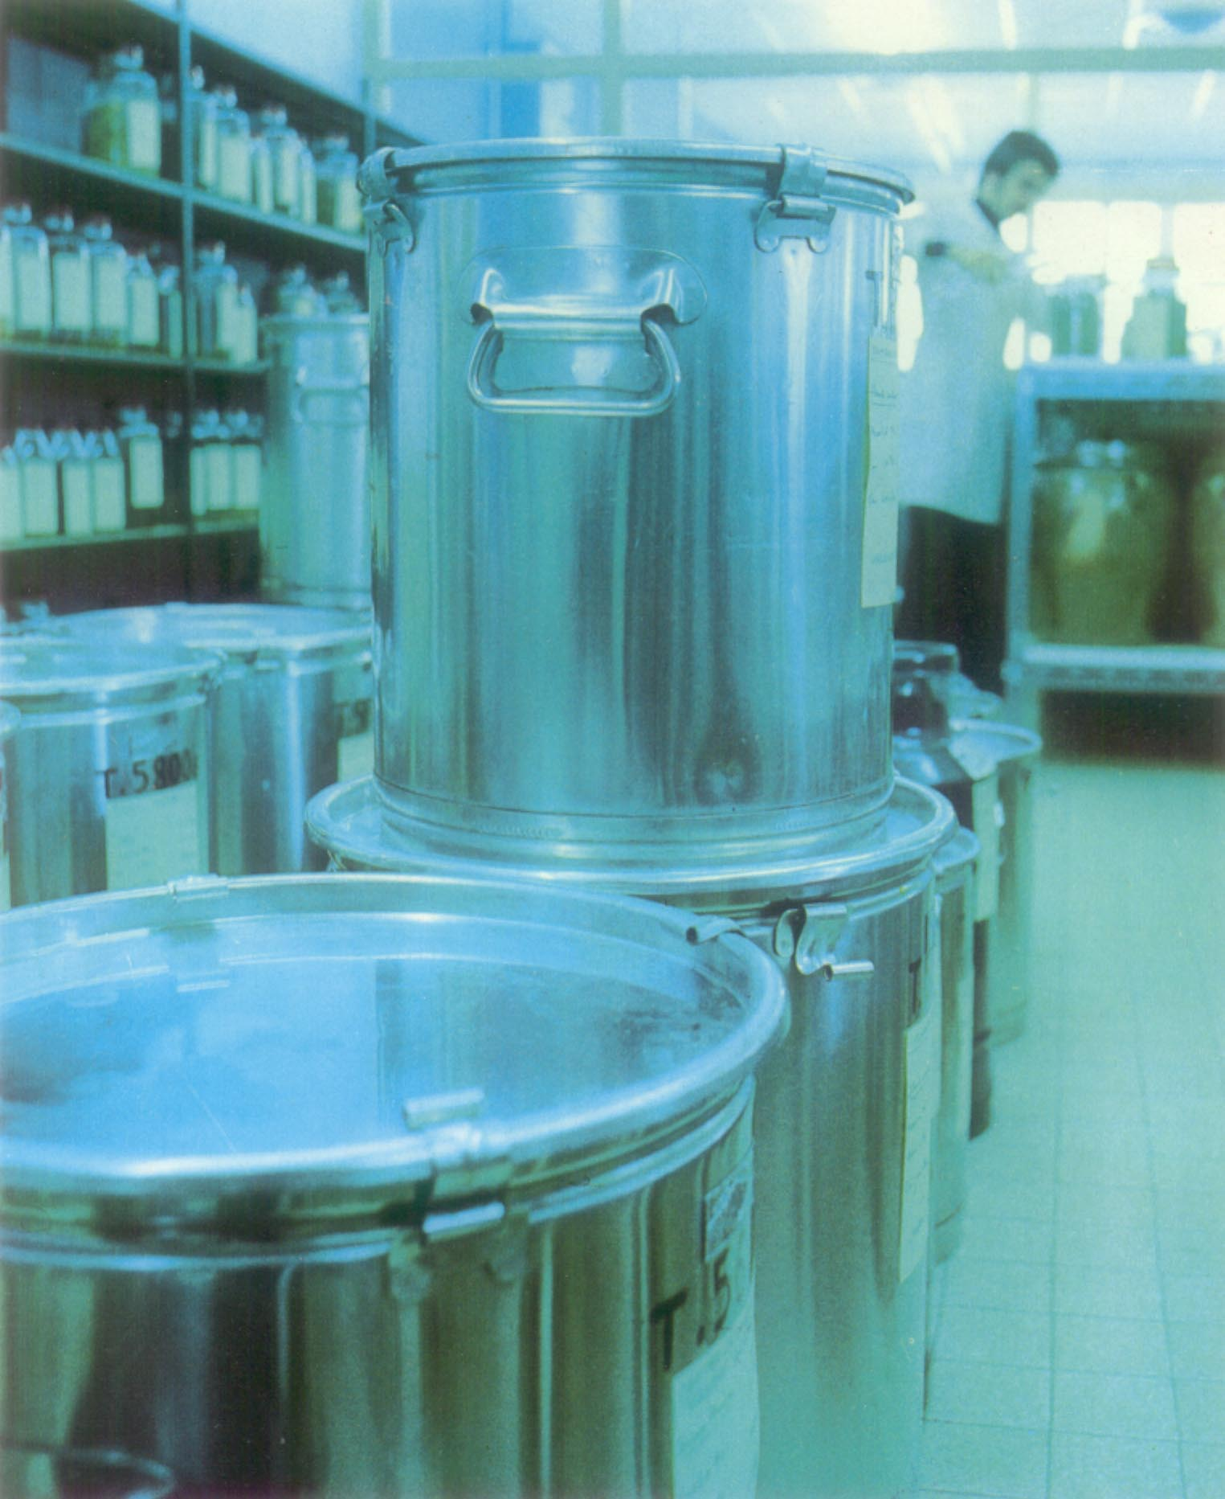
MACERATION
It is the long process of preparation of mother tincture in modern method from vegetable and animal sources using strong alcohol as solvent
under N.T.P. by keeping the drug in contact with menstrum for several days with frequent agitation

Slide 10
This process is preferable in preparation of mother tincture from drug material needing more time for extraction of active principles.
Eg : gummy and mucilaginous substances with viscid juice.

Slide 11
Plant moisture is ascertained and quantity of menstrum calculated accordingly.
Drug is reduced to pulp in a glazed mortar.
Place material into a macerating jar. Add pre-calculated quantity of solvent. Jar is stoppered to prevent evaporation and agitated daily.

Slide 12
Time required is 2 - 4 weeks.
Decant clear supernatant liquid and press out the residue through a press or a clean linen cloth or bag.
Having allowed the mixed products to stand twenty-four hours, filter.

Slide 13
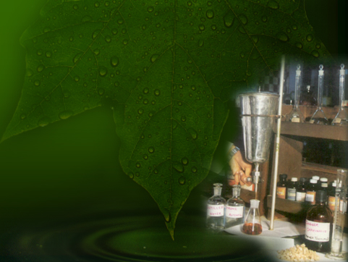
PERCOLATION
It is a short process of
extracting the soluble
constituents of a drug
and preparing the mother
tincture by the passage
of a solvent through the
Powdered drug contained
in a suitable vessel called
percolator for a definite
period of time as per
directions specified in
Pharmacopoeia.

Slide 14
PRINCIPLE OF OPERATION – FORCES INVOLVED
Gravitation
Weight of column of liquid
above the powder
Force of capillarity
Viscosity
Adhesion of the
packed drug substance

Slide 15
INDICATION
Percolation is adopted for
extraction of dry vegetable and
animal substances.
The utensil in which the drug is
packed is called a percolator.
APPARATUS

Slide 16
PROCESS OF PERCOLATION
Comminution
Moistening of the drug
Packing of the drug
Percolation
Termination of percolation

Slide 17
COMMINUTION
Drug should be reduced to particles
of more or less fineness.
The degree of fineness should be in
conformity with the specification
mentioned under each monograph
in the Pharmacopoeia.

Slide 18
MOISTENING OF THE DRUG
Before packing the drug in the percolator,
it is moistened with the menstrum, so that
when the drug comes in contact with the
menstrum, the compressed dried cells
are swollen to their normal size, and if this
swelling occurred within the percolator, it
would cause sufficient expansion to spoil
the percolation.

Slide 19
PACKING OF THE DRUG
TOW - a special sieving arrangement
Absorbent cotton in the neck.
Layer of coarsely powdered glass.
Layer of finely powdered glass.
Thin layer of coarse glass is packed.

Slide 20
Over this, the moistened pulp, taking care that mass is compact and free from fissures .
Cover the upper surface of the mass with a disc of filter paper or a thin layer of finely powdered glass or fine white sand.

Slide 21
PERCOLATION
Pour menstrum, in divided quantity upon the contents until the mass is covered, allowing the fluid to run gently down the glass rod .
Close percolator with lid to prevent dust.
Close valve as soon as fluid begins to drop and allow to stand for 24 hours.
Do not to allow flow to exceed 10-30 drops in a minute.

Slide 22
TERMINATION OF PERCOLATION
Residue left after process of percolation, called marc retains a considerable amount of the moisture - press it strongly to extract the remaining tincture from it. Add sufficient menstruum to make the required volume.
Resulting tincture is through filter paper into glass bottles and marked with the sign θ.

